Slide 1
“Collision avoidance algorithm for autonomous surface vehicles (ASVs) in compliance with COLREG“
A Masterthesis by Eric Greuel

Slide 2
Agenda
Motivation
  Autonomous surface vehicle (ASV)
  Collision avoidance (CA)
Fundamentals
  Guidance, navigation and control
  COLREGs
  Collision avoidance (Velocity obstacle)
Implementation
Results
Conclusion

Slide 3
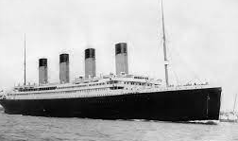
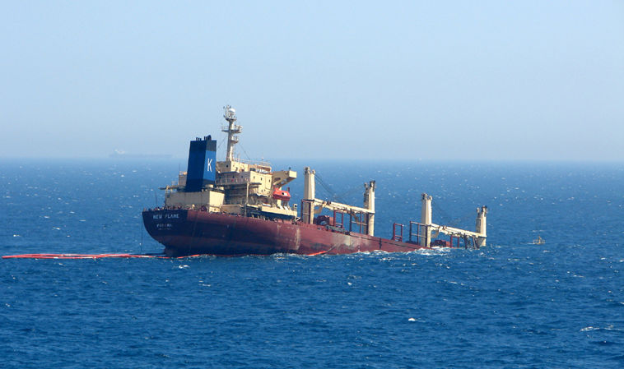
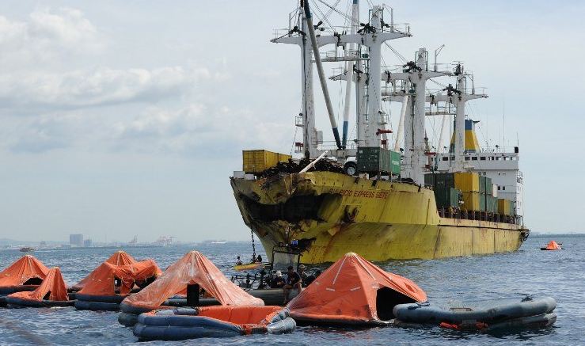
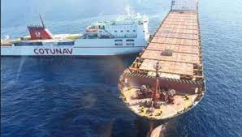
Motivation
Titanic (1912): 1490 – 1635 victims ^{[1]}
New Flame (2007): 22.5 million $ value of the ship ^{[2]}
St. Thomas Aquinas (2013): 108 victims, major environmental damage ^{[3]}
Ulysse (2018): 500 m³ oil released ^{[4]}
Notes:
New Flame Gibralta with oil tanker
St. Thomas Aquinas Ferry with cargo ship philipines
Ulysse Corsica with anchored container

Slide 4
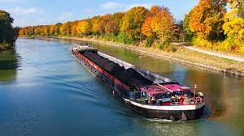
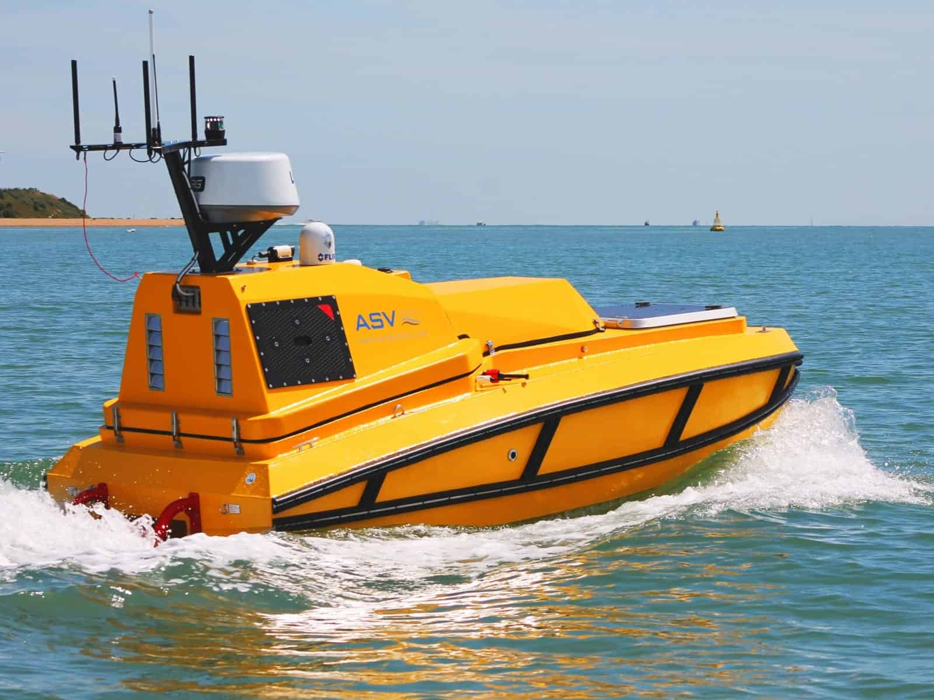
Motivation
Autonomous systems are gaining increasing attention worldwide with the aim of supporting humans or eliminating the human factor ^{[7]}
ASVs are typically used in: military operations, maritime surveillance, environmental monitoring ^{[7]}
ships carrying over 80 % of volume of global trade ^{[8]}
Problems:
  Labor shortage (≈ 147,500 officers by 2025) ^{[8]}
  High frequency of collisions (≈ 4000 per year) ^{[9]}
  54 % of all casualties with ships were navigational casualties ^{[9]}
  65.8 % were attributed to human erroneous actions ^{[9]}
Niedersachsen 22 (2023) ^{[5]}
Bathymetric Explorer and Navigator (2019) ^{[6]}
Notes:
- Fatalities during collision 51.9 %
- Injuries during collision 52.9 %
- 2/3 of pollution incidenc are sea pollution

Slide 5
Motivation
Advantages of ASVs ^{[7]}:
  Improving safety
  Compensating labor shortage
  Longer performance time
  Reduce personnel costs and improve personnel safety
  Reducing the risk of kidnapping during piracy
  Increased cargo space
safe autonomous systems on water require a reliable guidance, navigation
and control (GNC) system ^{[10]}
Collision avoidance plays an important part in obtaining a reliable GNC system

Slide 6
Motivation
Advantages of ASVs ^{[7]}:
  Improving safety by reducing accidents caused by humans
  Compensating labor shortage in the maritime transport industry
  Longer performance time compared to humans
  Reduce personnel costs and improve personnel safety and security
  Reducing the risk of kidnapping during piracy
  Increased cargo space by removing crew facilities
safe autonomous systems on water require a reliable guidance, navigation
and control (GNC) system ^{[10]}
Collision avoidance plays an important part in obtaining a reliable GNC system

Slide 7
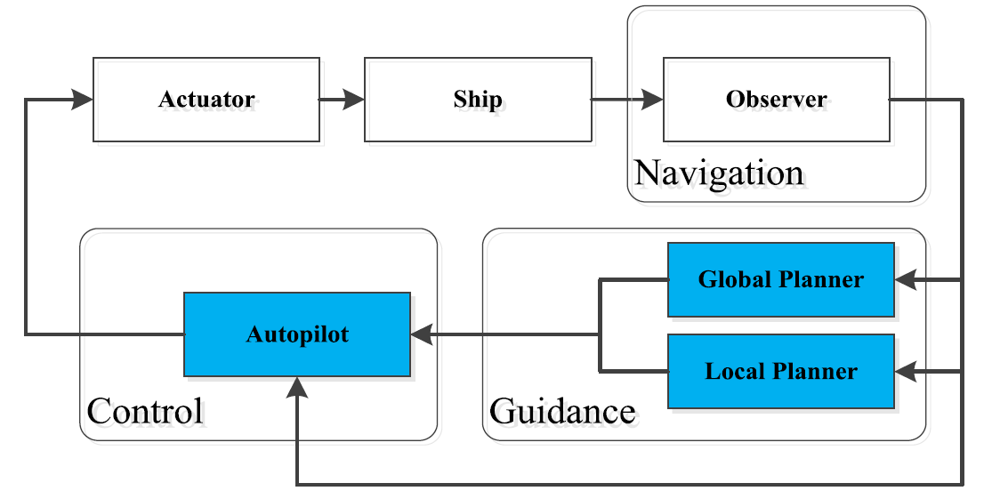
Guidance, navigation and control
GNC control system for ASVs ^{[10]}
Navigation: Identification of current and future states of the ASV (pose, velocity, acceleration, etc.) and detection of the surrounding environment with information obtained by sensors (sonar, GPS, etc.) ^{[11]}
Guidance: Generation of optimal and feasible trajectory command (path planning, collision avoidance, etc.) ^{[11]}
Control: Determination of proper control forces to match the current state and desired future states provided by navigation and guidance ^{[11]}

Slide 8
Path planning
Global path planning: finds a safe path from the initial state to the goal state considering known obstacles and assuming that a complete model of the environment is available (offline) [3]
Local path planning: uses the information about the local environment around the vessel taking into consideration information from sensors putting emphasis on avoiding dynamic obstacles in the vicinity to generate a feasible and safe path (online, reactive) [3]

Slide 9
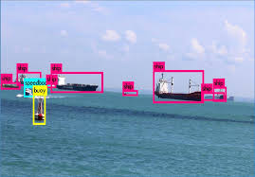
Object detection (Navigation)
Goal: Detect static and dynamic objects (Position, Velocity)
Sensors: Radar and Camera
Convolutional Neural Network (CNN) like FCOS, SSD or MaskRCNN for object detection in camera images [2]
Camera and Radar Fusion for object detection [3]
Radar classification of targets in terms of a collision threat [4]

Slide 10
What are COLREGs?
COLREGs is the international regulations for preventing collisions at sea formalized by International Maritime Organization (IMO) in 1972 ^{[12]}
It includes 41 rules divided in six sections ^{[12]}
  Part A – General
  Part B – Steering and Sailing
  Part C – Lights and Shapes
  Part D – Sound and Light signals
  Part E – Exemptions
  Part F – Verification of compliance with the provisions of the Convention
Part B consists of regulations with importance for collision avoidance
Notes:
Part B states action to be taken when two vessels approach each other

Slide 11
What are COLREGs?
COLREGs specify several possible encounters ^{[12]}
  Rule 7: Risk of collision (Use all available means to determine a possible risk of collision)
  Rule 8: Action to avoid a collision (course change is preferred, passing in safe distance, substantial change in ample time)
  Rule 13: Overtaking - 22.5° abaft the vessel beam (keep out of the way of the vessel being overtaken)
  Rule 14: Head-on situation (meeting on reciprocal courses, both vessels alter course to starboard)
  Rule 15: Crossing situation (if the other vessels is on starboard side, own vessels alters course to starboard, try to avoid crossing ahead of the other vessel)
  Rule 16: Action by give-away vessel (should take early and substantial action)
  Rule 17: Action by stand-on vessel (should keep course and speed, but change course a soon at is become apparent that the other vessel is not taking any action, for crossing not change to port)
  Rule 18: Responsibility between vessels (power driven, sailing, fishing, etc.)
Notes:
Due to the reason the COLREGs are quite vage and not quantified

Slide 12
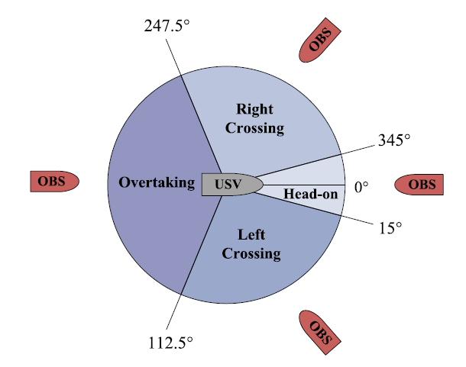
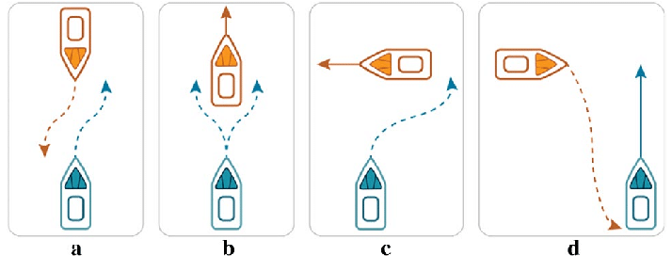
Classify COLREGs
only necessary if a risk of collision was detected
relative bearing and course over ground (COG) of TS and OS determine which COLREG rule should be applied
Colreg classification ^{[18]}
Colreg encounter types: (a) Head-on (b) Overtaking and Being-overtaken (c) Right-crossing (d) Left-crossing ^{[14]}

Slide 13
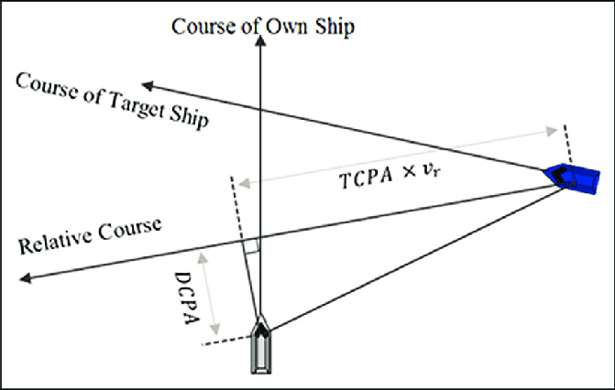
Collision avoidance
Collision detection
Detection of a possible collision and assessment of the collision risk
Two types: Expert-based, Model-based
Closest point of approaching (CPA) ^{[15]}
Ship domains ^{[16]}
Collision resolution
Determination of collision-free solutions for the ASV ^{[10]}
Several algorithms have been developed: ^{[10, 17]}
  Artificial Potential Field (APF)
  Limited Cycle Method (LCM)
  Decision Disc approach (DD)
  Dynamic Window approach (DW)
  Lattice-based search (LGS)
  Velocity Obstacle (VO)
  Vision Cone (VC)
  Model Predictive Control (MPC) methodes
Concept of closest point of approach ^{[7]}

Slide 14
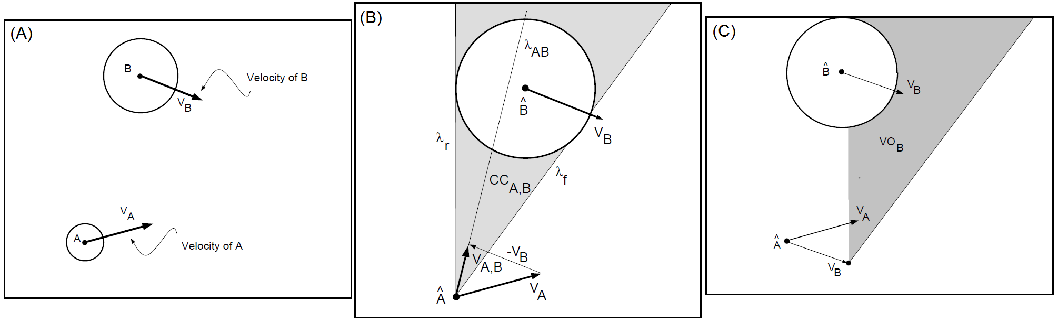
Velocity Obstacle (VO)
Velocity obstacle: „set of all velocities of a robot that will result in a collision with another robot at some moment in time”
  Expand obstacle with the shape of own robot → own robot becomes a point
  Calculate the collision cone (CC)
  Add the relative velocity of the TS to the CC to get the VO
Velocity obstacle (VO) Fiorini 1998 ^{[18]}

Slide 15
Implementation
Collision Risk estimation
Classify the COLREG encounter situation
Calculate all feasable velocities
Choose the best velocity from the feasable velocity
Avoid the collision

Slide 16
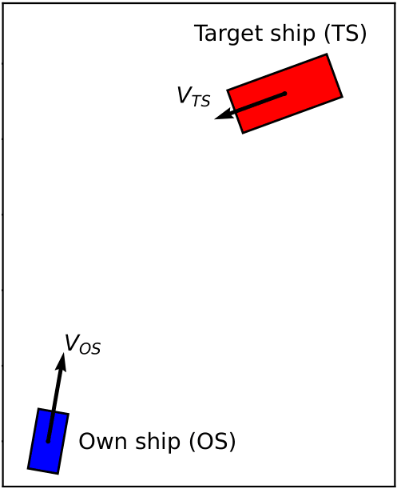
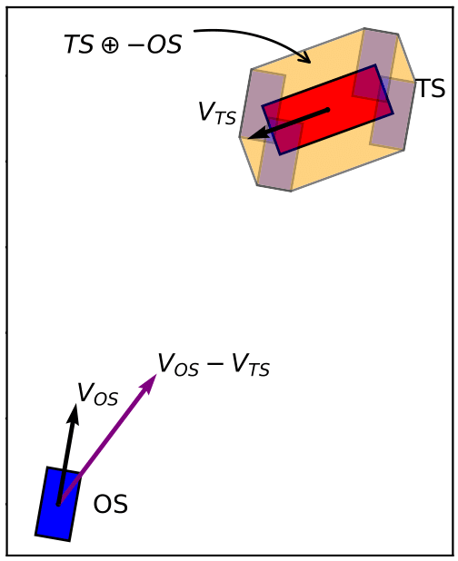
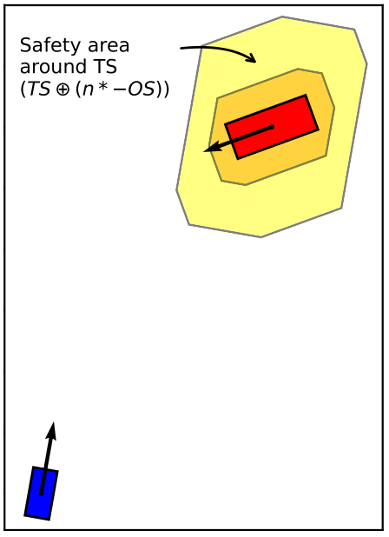
Implementation (Safety area)
Minkowski sum to expand the shape of TS with the shape of OS
Safety area around the OS expanded to TS (area to keep clear of other vessels)

Slide 17
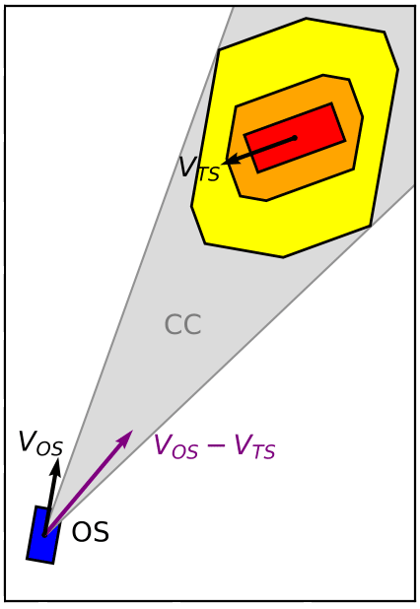

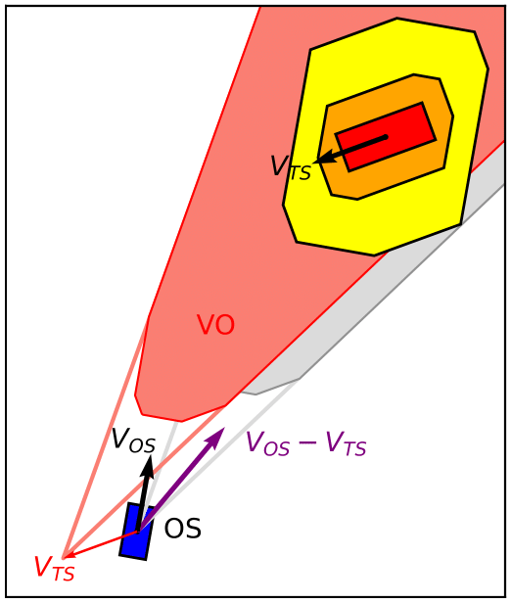
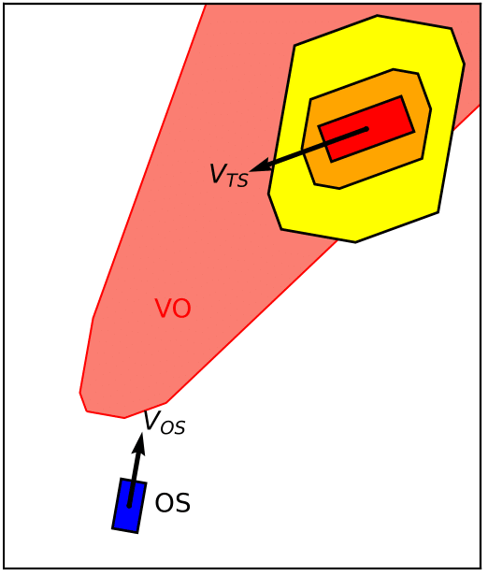
Implementation (CC and VO)
Collision Cone (CC): set of relative velocities leading to collision at any time
Velocity Obstacle (VO): set of absolute velocities leading to a collision
CC = {vr|vrt ∩ T ≠ Ø, ∀t ≥ 0} ^{[19]} VO = CC⊕vTS ^{[19]}

Slide 18
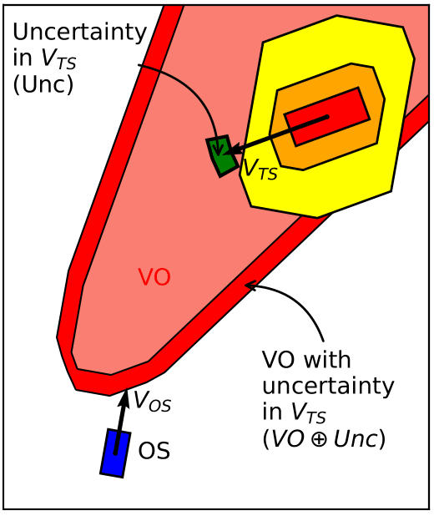
Implementation (Uncertainty)
Uncertainty comes from sensors tracking the target ship like camera, radar and lidar (noise and state estimation errors) ^{[19]}
Another source for uncertainty comes from the imprecise movement of the target ship
VO assumes a constant linear velocity, in reality the target ship does not necessarily maintain constant velocity

Slide 19
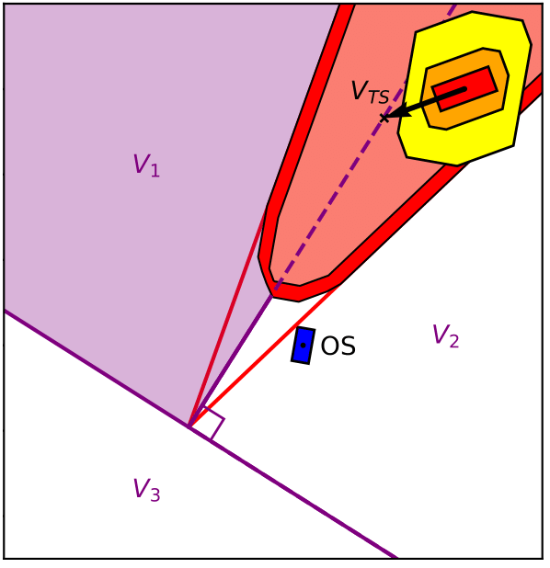
Implementation (COLREG)
VO divides the velocity space into three areas V1,V2 and V3
V1: Pass with obstacle on starboard side
V2: Pass with obstacle on port side
V3: Move away from the obstacle
Velocities in V1 are equal to the velocities that should be avoided according to COLREG in case of give-away vessel

Slide 20
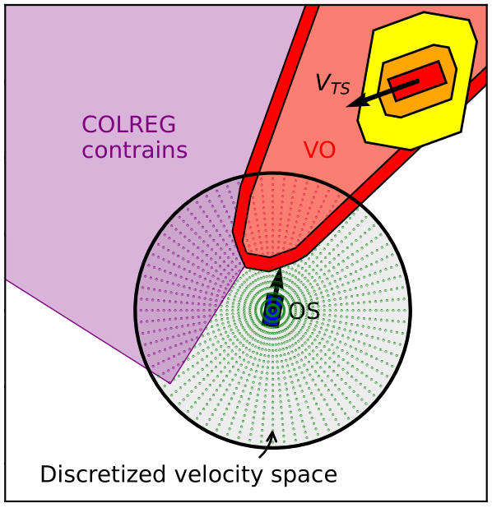
Implementation (Discretized velocity space)
Set of discrete velocity vectors
Set of speeds with a set of course angles
With max speed of OS as limit
All velocities outside of the VO and the COLREG constrains are feasible velocities to choose from
Cost function to find the optimal velocity

Slide 21
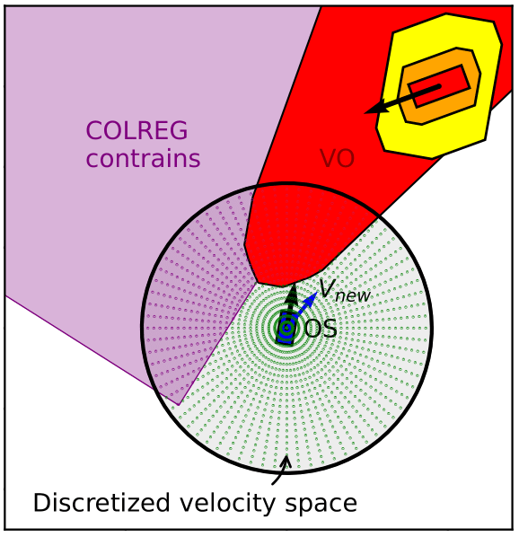
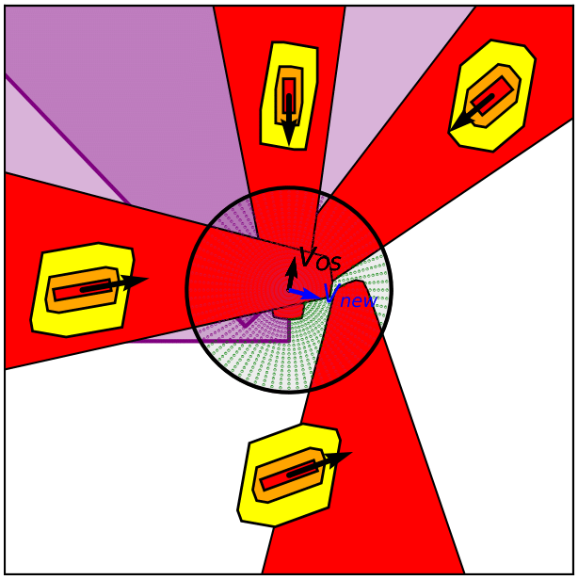
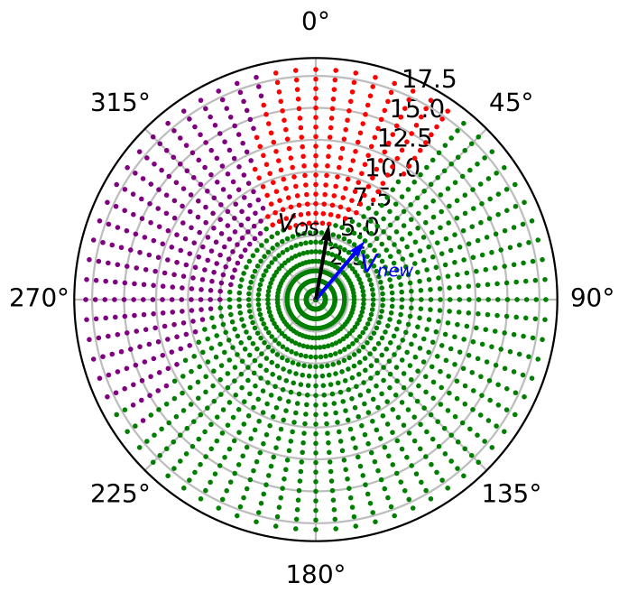
Implementation (New velocity)

Slide 22
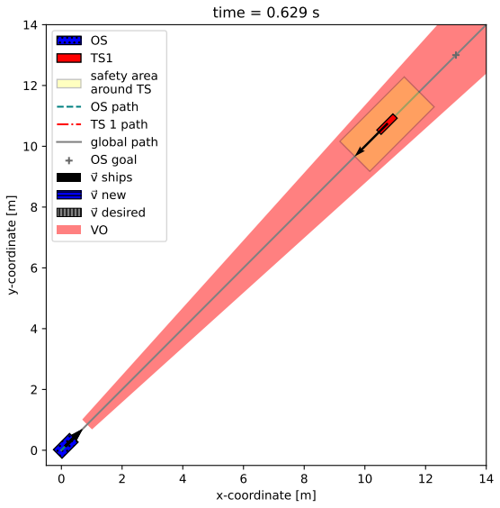
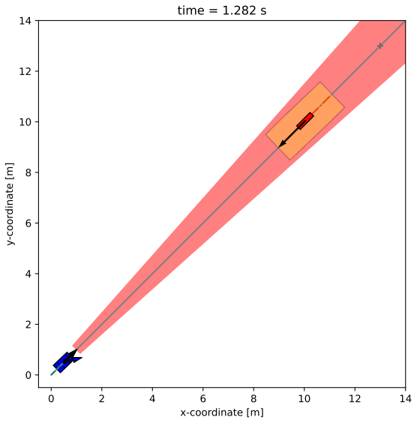
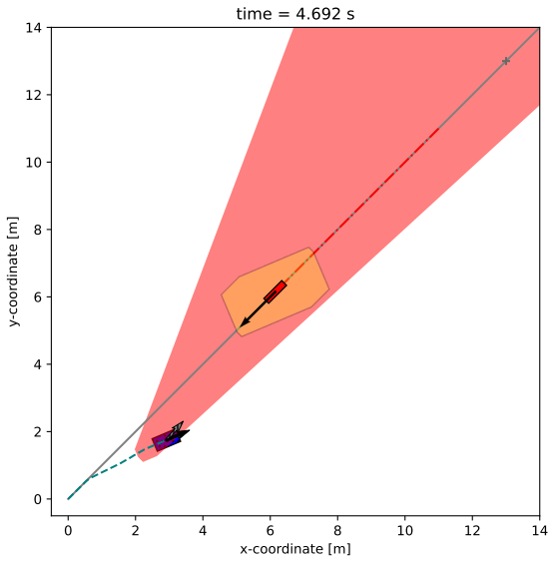
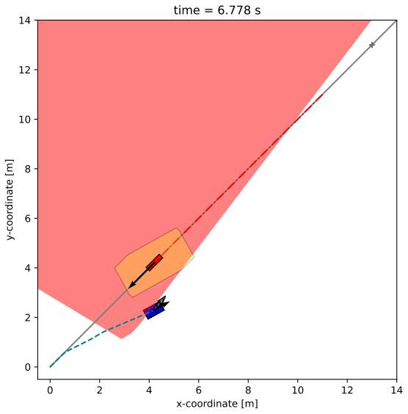
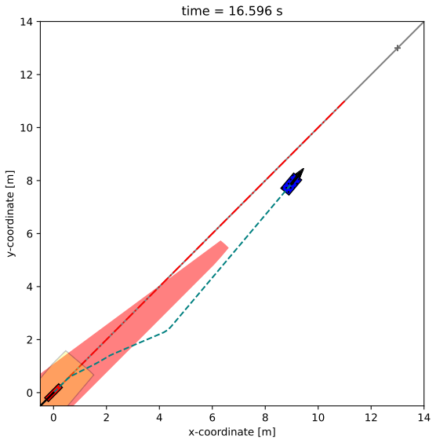
Results (Turtlesim - Head-on)

Slide 23
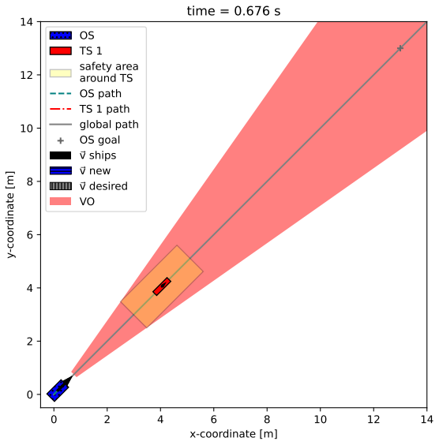
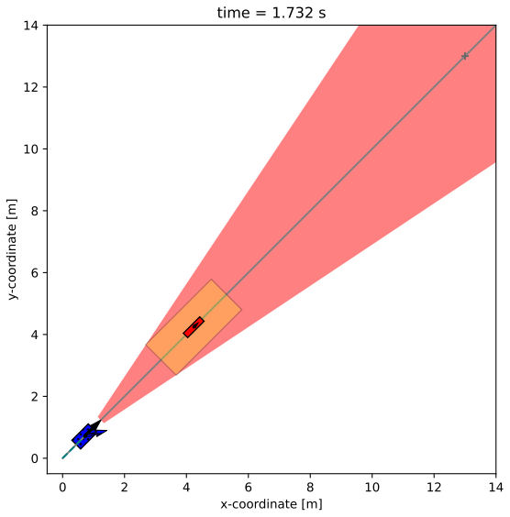
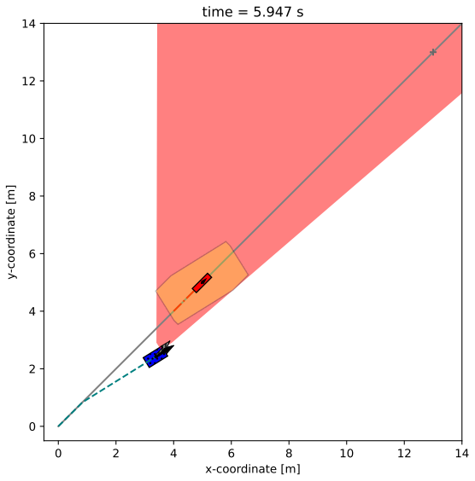
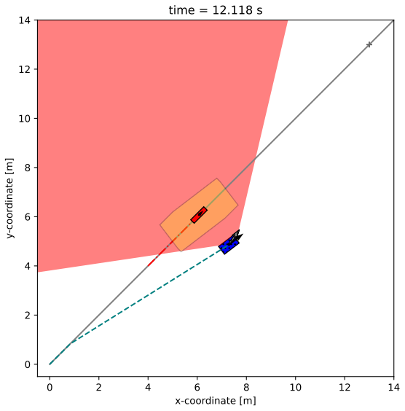
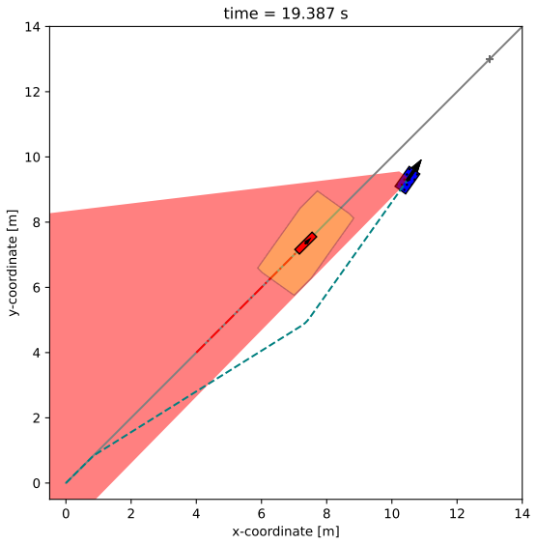
Results (Turtlesim - Overtaking)

Slide 24
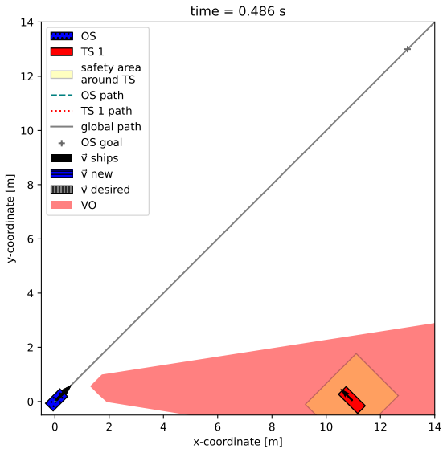
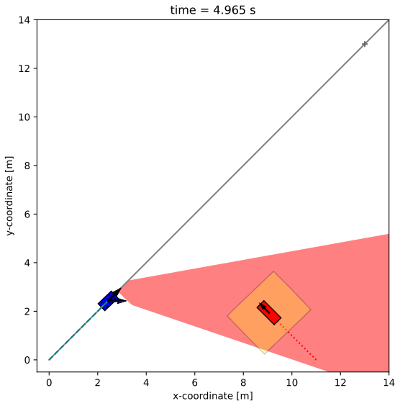
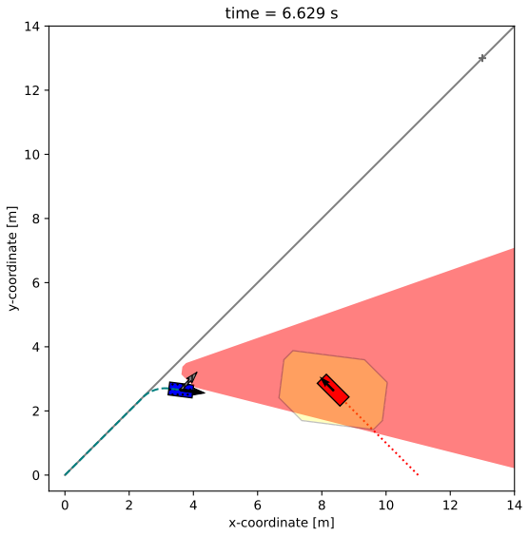
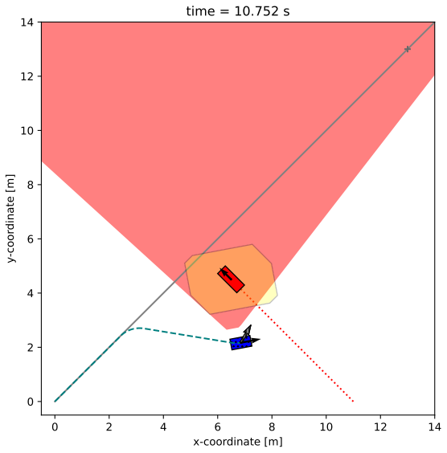
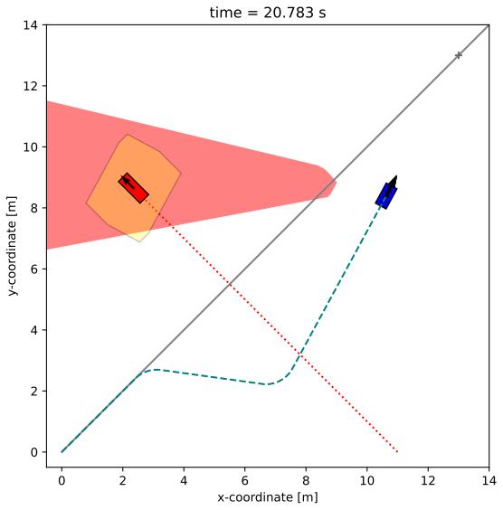
Results (Turtlesim – Right crossing)

Slide 25
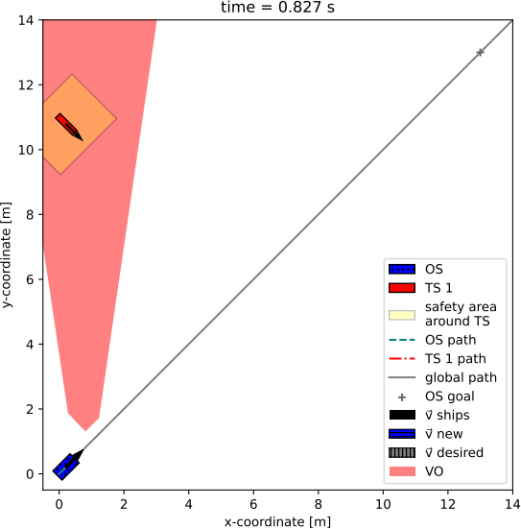
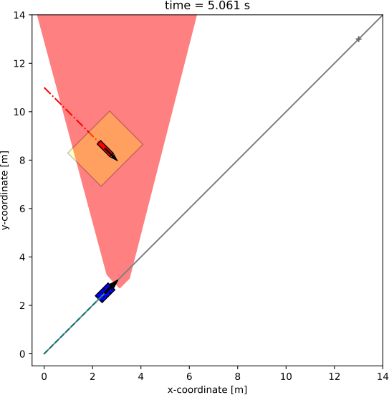
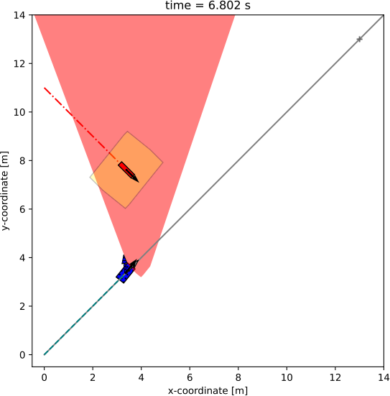
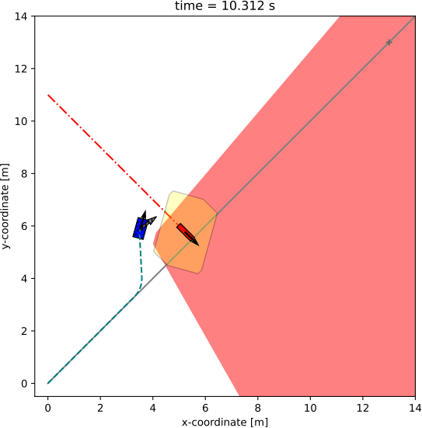
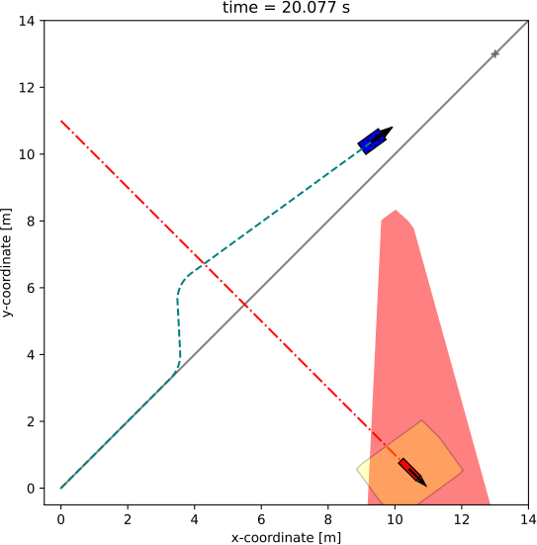
Results (Turtlesim – Left crossing)

Slide 26
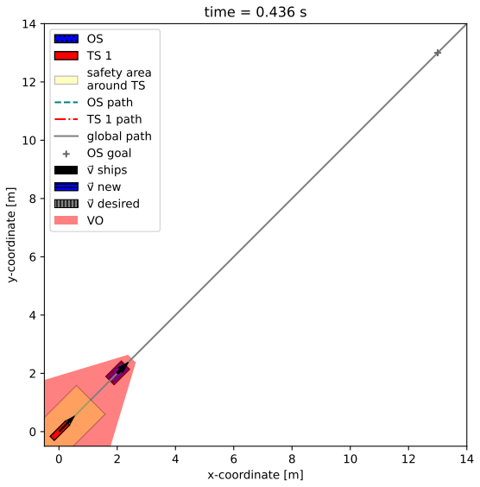
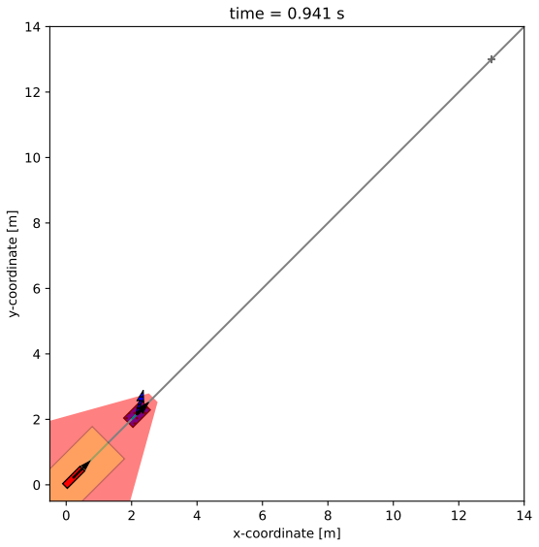
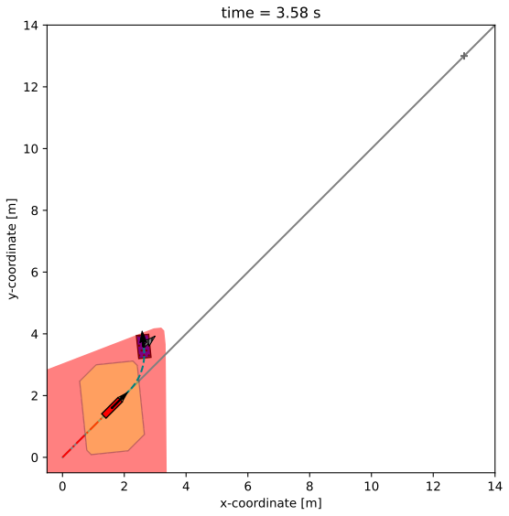
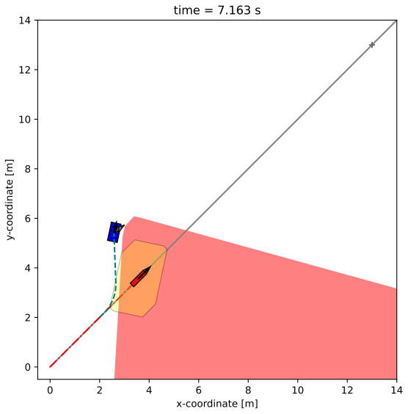
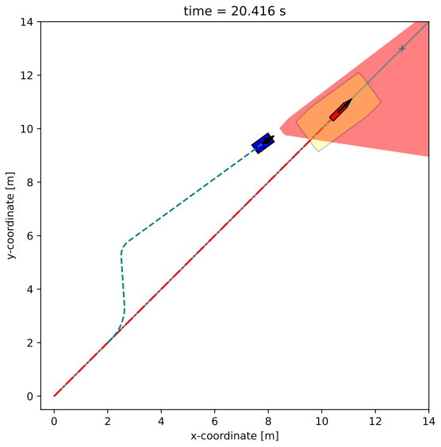
Results (Turtlesim - Overtaken)

Slide 27
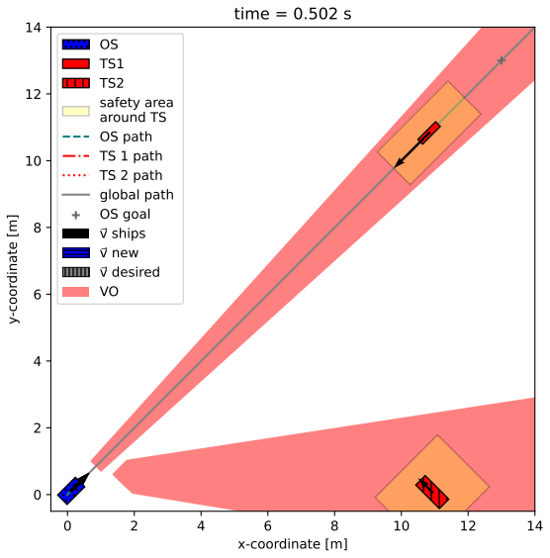







Results (Turtlesim – Head-on/Right crossing)

Slide 28
Results (Unity MARUS)
MARUS – Marine Robotics Unity Simulator
Capable of high-end graphics, GPU utilization, simple test scene design, physics simulation, ocean simulation with dynamic waves and object interaction ^{[20]}
Offers a wide array of sensors commonly used in underwater and maritime domain ^{[20]}

Slide 29




Results (Unity – Head-on)
Detection range of obstacles = 50 m
Speed of TS = 3 m/s
OS is give-away vessels
OS passes according to COLREG with TS on port side
OS changes course to starboard according to COLREG

Slide 30




Results (Unity – Head-on)
Detection range of obstacles = 50 m
Speed of TS = 5 m/s
OS is give-away vessels
OS passes according to COLREG with TS on port side
OS changes course to starboard according to COLREG

Slide 31




Results (Unity – Head-on)
Detection range of obstacles = 50 m
Speed of TS = 7.5 m/s
OS is give-away vessels
OS passes according to COLREG with TS on port side
OS changes course to starboard according to COLREG

Slide 32




Results (Unity – Head-on)
Detection range of obstacles =
200 m
Speed of TS = 7.5 m/s
OS is give-away vessels
OS passes according to COLREG with TS on port side
OS changes course to starboard according to COLREG

Slide 33




Results (Unity – Right crossing)
Detection range of obstacles = 50 m
Speed of TS = 3 m/s
OS is give-away vessels
OS passes according to COLREG with TS on port side
OS changes course to starboard according to COLREG

Slide 34




Results (Unity – Left crossing)
Detection range of obstacles = 50 m
Speed of TS = 3 m/s
OS is stand-on vessel
OS passes according to COLREG with TS on port side

Slide 35




Results (Unity – Overtaking)
Detection range of obstacles = 50 m
Speed of TS = 1.5 m/s
OS is give-away vessel
OS passes according to COLREG with TS on port side
OS changes course to starboard

Slide 36




Results (Unity – Overtaking, static obstacle)
Detection range of obstacles = 50 m
Speed of TS = 0 m/s
OS is give-away vessel
OS passes according to COLREG with TS on port side
OS changes course to starboard

Slide 37




Results (Unity – Multiple target ships)
Detection range of obstacles = 50 m
Speed of TS 1 = 3 m/s
Speed of TS 2 = 3 m/s
OS is give-away vessel in both encounters
OS passes according to COLREG with TSs on port side
OS changes course to starboard

Slide 38




Results (Unity – Multiple target ships)
Detection range of obstacles = 50 m
Speed of TS 1 = 3 m/s
Speed of TS 2 = 3 m/s
OS is give-away vessel for head-on and stand-by for left-crossing encounter
OS passes according to COLREG with TSs on port side
OS changes course to starboard

Slide 39




Results (Unity – Multiple target ships)
Detection range of obstacles = 50 m
Speed of TS 1 = 3 m/s
Speed of TS 2 = 3 m/s
OS is give-away vessel both encounters
OS passes according to COLREG with TSs on port side
OS changes course to starboard

Slide 40
Conclusion
Dynamic and static objects can be avoided safely
Multiple obstacles can be avoided safely
Collision avoidance maneuver is in compliance with COLREG (substantial, early)
Performance of the collision avoidance algorithm depends on the performance of the navigation and control system
Further validation by on-water experiments with experts rating the maneuvers
Dynamic model of the actual ship can improve the algorithm in simulation and in on-water experiments
Notes:
Part B states action to be taken when two vessels approach each other

Slide 41
Sources
[1] http://www.uwants.com/viewthread.php?tid=3817223&extra=page%3D1
[2] https://commons.wikimedia.org/wiki/File:New_flame_sinking.JPG
[3] https://www.rappler.com/nation/36822-cebu-collision-captains-blame-each-other/
[4] https://www.nautilusint.org/en/news-insight/news/watchkeeper-error-blamed-for-ulysse-and-csl-virginia-collision/
[5] https://www.heise.de/hintergrund/Schifffahrt-Steuermann-von-Bord-4886039.html
[6] https://www.nhbr.com/unh-technology-utilized-in-effort-to-solve-amelia-earhart-disappearance/
[7] Vagale, A., Oucheikh, R., Bye, R. T., Osen, O. L., & Fossen, T. I. (2021). Path planning and collision avoidance for autonomous surface vehicles I: a review. In Journal of Marine Science and Technology (Japan) (Vol. 26, Issue 4, pp. 1292–1306). https://doi.org/10.1007/s00773-020-00787-6
[8] UNCTAD. (2022). Review of maritime transport 2022. United Nations Conference on Trade and Development, 195.
[9] European Maritime Safety Agency (2019) Annual Overview of Marine Casualties and Incidents 2019. Technical report, European Maritime Safety Agency
[10] Huang, Y., Chen, L., Chen, P., Negenborn, R. R., & van Gelder, P. H. A. J. M. (2020). Ship collision avoidance methods: State-of-the-art. Safety Science, 121, 451–473. https://doi.org/10.1016/J.SSCI.2019.09.018
[11] Oude Grote Bevelsborg, R. W. (2019). A Novel Fast Marching Approach for COLREGS Compliant Dynamic Obstacle Avoidance for Unmanned Surface Vehicles. https://repository.tudelft.nl/islandora/object/uuid%3A3c22ad76-0d80-4d28-88eb-ca1ff2d62b72
[12] International Maritime Organization. (1972). Convention on the International Regulations for Preventing Collisions at Sea (COLREG). In The Legal Order of the Oceans (Vol. 1972, Issue July). https://doi.org/10.5040/9781509955572.0024
[13] Woo, Joohyun & Kim, Nakwan. (2015). Vision-based target motion analysis and collision avoidance of unmanned surface vehicles. Proceedings of the Institution of Mechanical Engineers, Part M: Journal of Engineering for the Maritime Environment. 230. 10.1177/1475090215605136.
[14] Path planning and collision avoidance for autonomous surface vehicles I: a review - Scientific Figure on ResearchGate. Available from: https://www.researchgate.net/figure/Four-encounter-situations-of-power-driven-vessels-according-to-the-COLREGs-rules-13-15_fig1_348893179 [accessed 25 Apr, 2023]
[15] Ozturk, U., & Cicek, K. (2019). Individual collision risk assessment in ship navigation: A systematic literature review. In Ocean Engineering (Vol. 180, pp. 130–143). Pergamon. https://doi.org/10.
[16] Zhang, L., & Meng, Q. (2019). Probabilistic ship domain with applications to ship collision risk assessment. Ocean Engineering, 186. https://doi.org/10.1016/j.oceaneng.2019.106130
[17] Öztürk, Ü., Akdağ, M., & Ayabakan, T. (2022). A review of path planning algorithms in maritime autonomous surface ships: Navigation safety perspective. Ocean Engineering, 251. https://doi.org/10.1016/J.OCEANENG.2022.111010
[18] Xia, G., Han, Z., Zhao, B., & Wang, X. (2020). Unmanned Surface Vehicle Collision Avoidance Trajectory Planning in an Uncertain Environment. IEEE Access, 8, 207844–207857. https://doi.org/10.1109/ACCESS.2020.3038187
[19] Fiorini, P., & Shiller, Z. (1998). Motion planning in dynamic environments using velocity obstacles. International Journal of Robotics Research, 17(7), 760–772. https://doi.org/10.1177/027836499801700706
[20] I. Lončar et al., "MARUS - A Marine Robotics Simulator," OCEANS 2022, Hampton Roads, Hampton Roads, VA, USA, 2022, pp. 1-7, doi: 10.1109/OCEANS47191.2022.9976969.

Slide 42
The end!
Questions?

